Slide 1

$Convert \frac{2}{7} into a decimal number and then a percentage.$
Find the area of this parallelogram.
3. What is the value of 5²
How do I find 12% of $50
5. If I travel at 80km/hr, how far would I go in 15 minutes
15mm
6mm
5mm

Slide 2
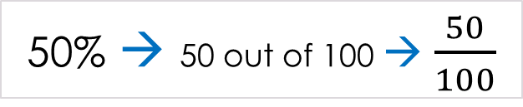
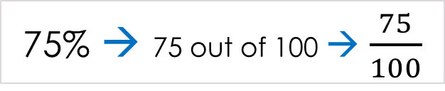
Topic: Fractions, decimals, & percentages
EQ: How do I convert between fractions, decimals and percentages?
Question:
Explanation:
Example:
The symbol, %, means ‘per cent’, which means “out of 100”.
Therefore, 75% means 75 out of 100.
We can write percentages as fractions by changing the % sign to a denominator of 100 (meaning out of 100)
What is a percentage?
50% → 50 out of 100 → $\frac{50}{100}$
75% → 75 out of 100 → $\frac{75}{100}$
Can we simplify these fractions?
Notes:
We can simplify them to ½ and ¾

Slide 3
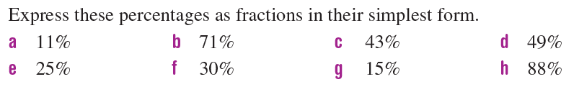
Left-Hand-Side Task 2
Check your answers!
a. 11/100 b. 71/100 c. 43/100 d. 49/100 e. 1/4 f. 3/10 g. 3/20 h. 22/25

Slide 4
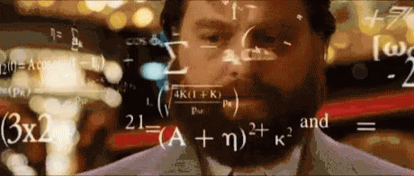
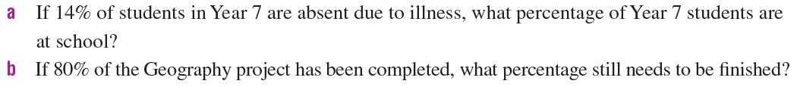
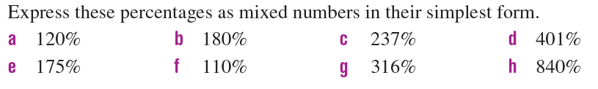
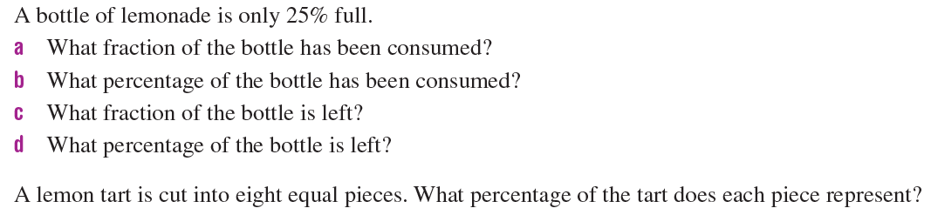
Left-Hand-Side Task 3
Notes:
1a. 86% 1b. 20% 2a. 120/100=12/10=6/5=1 1/5 2b. 180/100=18/10=9/5=1 4/5 2c. 237/100=2 37/100 2d. 401/100=4 1/100 2e. 175/100=35/20=7/4=1 ¾
2f. 110/100=11/10=1 1/10 2g. 316/100=79/25=3 4/25 2h. 840/100=84/10=8 4/10=8 2/5
3a. ¾ 3b. 75% 3c. ¼ 3d. 25%
4. 12.5%

